Slide 1
The Industrial Revolution: 1750-1830 The French Revolution: 1789-1799
What did they mean for the discipline of sociology?
Robert Nisbet (The Sociological Tradition)

Slide 2
Significance
In many ways these revolutions signified the break-up of the old order – the feudal order- at the beginning of the 19th century
Industrial Revolution – Mechanization and Mass manufacture – generation of surpluses
French Revolution - First great ideological revolution in Western history.

Slide 3
Major concerns and fundamental ideas generated in sociology
industry, democracy, class, middle and working class, ideology, intellectual, rationalism, masses, proletariat, bourgeoisie, collectivism, bourgeoisie, conservative, bureaucracy, capitalism, crisis.
Two central ideas emerged: industrialism and revolutionary democracy

Slide 4
Issues of importance
What were the issues that emerged?
The nature of ‘community’
The Location of Power
The stratification of wealth and privilege

Slide 5
Issues (contd.)
The role of the individual in emerging mass society
The reconciliation of sacred values with political and economic realities- the place of religion in modern society
The direction of Western society

Slide 6
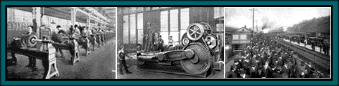
The Industrial Revolution 1750-1830

Slide 7
Industrial Revolution
Started with the mechanization of the textile industries, the development of iron-making techniques and the increased use of refined coal. The steam engine; Transportation.
The Industrial Revolution began an era of per-capita economic growth in capitalist economies.
Made possible the subduing of nature

Slide 8
Views
Radicals
Liberals
Conservatives

Slide 9
Consequences of the Industrial Revolution – of Industrialism
The transformation of the nature of property
Attitudes towards property of conservatives and liberals.
For conservatives – property was the basis of family, church, state and all other groups in society
For radicals – the abolition of property became the prime goal

Slide 10
Property and Labour
Hatred of large-scale industrial property and especially of abstract and impersonal type of property – shares bought and sold on the market – represented by the figure of the ‘speculator’.
The condition of labour – the working class; degradation of labour; the wrenching of work from the protective contexts of guild, village and family
Threat to the traditional family

Slide 11
Issues brought up by the IR
The industrial city
Urbanism
changed social character of the city – from medieval towns to cities
the negative view of the city – disorganization; alienation, mental isolation; loss of community and membership; growth in nos.; squalor, filth
Engels; Manchester; Marx – favoured the urban over the rural

Slide 12

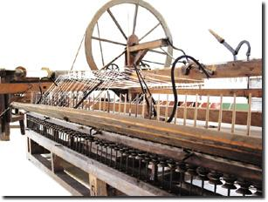
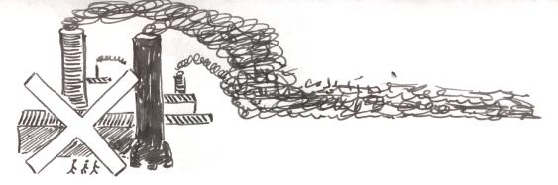
IR (contd.)
Technology, Machinery and the factory system
Changing nature of work

Slide 13
Views on Machinery
Conservatives: saw machinery as evil, turning man into a mechanical being (Ruskin, Blake, Gandhi in India); the extinction of the artisan.
Group called “Luddites” who were also against machinery and sabotaged factories.
Radicals: identified the problems of alienation of labour and enslavement to the machine as a consequence of private property and not inherently of mechanization and the factory system (Marx).

Slide 14
Social Consequences
Triumph of middle class of industrialists and businessmen over the landed class of nobility and gentry.

Slide 15
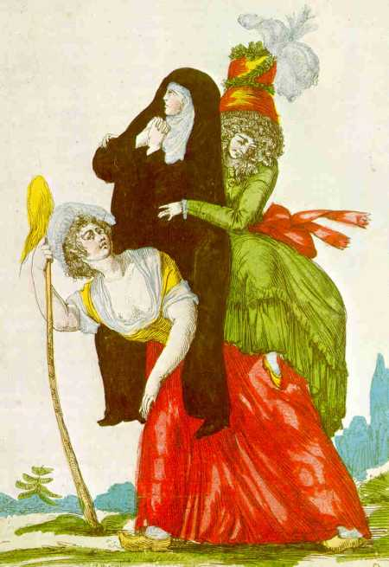
Why the French Revolution?
Deep social and political discontent among the half-hungry and dispossessed was one of the prime causes of the French Revolution, here exemplified by the burden of the French peasants in 1789 as they support the double weight of the clergy and the nobility.

Slide 16
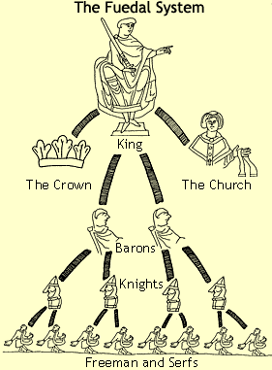
Europe in the middle ages

Slide 17
System of Estates
Clergy
Nobility
Commoners (bourgeoisie and peasants)
Estates were based on inherited occupations, membership by birth
French revolted against the hated authorities of Church, Aristocracy, Guild and Monarchy.

Slide 18
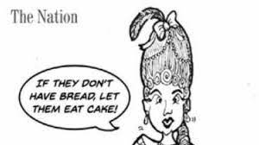
Marie Antoinette and King Louis XV1

Slide 19
Reign of Terror
From power to terror
During the French Revolution, the guillotine became the primary symbol of the Reign of Terror and was used to execute thousands of people, including King Louis XVI and Marie-Antoinette.
Counter-revolutionaries and traitors were guillotined – revolution and the justification of violence

Slide 20
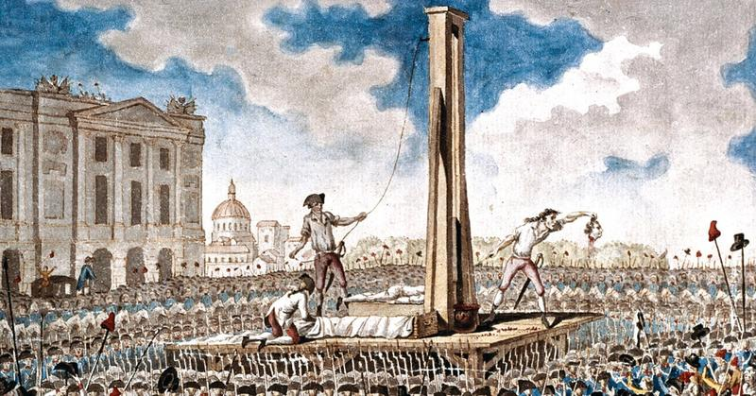
The guillotine – execution of opponents of the Revolution

Slide 21
Novel and Film on the FR
Charles Dickens – A tale of two cities
Depicting the brutality of the French Revolution

Slide 22
FR
Why was the French Revolution a Revolution?
An ideological revolution – a revolution of ideas
(as opposed to the Industrial Revolution that revolutionized production by the application of science and technology)

Slide 23
Slogan of the French Revolution: Liberty, Equality, Fraternity
“The Declaration of the Rights of Man and Citizen” 1789
“Law is the expression of the general will.
All citizens have the right to take part, personally or by their representatives in its formation.
It must be the same for all whether it protects or punishes.

Slide 24
Cont.
All citizens, being equal in its eyes, are equally eligible to all public dignities, places and employments, according to their capacities, and without other distinctions than those of their virtues and talents.”

Slide 25
The American Declaration of Independence (1776)
Influenced the French Revolution but focus and emphasis of latter was different.
It was influential but not as a statement of human rights.
“We hold these truths to be self-evident, that all men are created equal, that they are endowed by their Creator with certain unalienable Rights, that among these are Life, Liberty and the pursuit of Happiness.”

Slide 26
Impact
Slogan of the French Revolution
“Liberty, Equality, Fraternity”
Ideas of the French Revolution -
Equalitarianism, Popular Sovereignty and Individualism – the first thoroughly “ideological revolution”
Inspiration - J-J Rousseau and Alexis de Tocqueville

Slide 27
Ideas
Equalitarianism became the compelling moral ethos of the revolution.
Individualism – separation of the individual from communal/corporate structures, from guild, village community, church, caste or estate and from patriarchal ties in general.
Group vs individual
Guild vs entrepreneur
Class/estate vs citizen
Liturgical tradition vs individual reason

Slide 28
What the revolution meant
A unique blend of:
Power and freedom (liberation)
Power and equality (citizenship)
Power and fraternity (citizenship of a nation)
Power and reason – rational exercise of power in governance

Slide 29
Socialism
The history of socialism has its origins in the 1789 French Revolution

Slide 30

Women’s Rights
Olympia de Gouges wrote the Declaration of the Rights of Women and the Citizeness (1791), possibly the best known tract on the rights of women from the period, as a response to the Declaration of the Rights of Man and its silence regarding women.

Slide 31
Cont.
Revolutionary era women wanted:
equality of rights within marriage
the right to divorce
extended rights of widows over property and of widowed mothers over their minor children
publicly guaranteed educational opportunities for girls (including vocational training for poor girls)
public training, licensing, and support for midwives in all provinces
guaranteed right to employment
and the exclusion of men from specific traditionally-female professions, like dress-making.

Slide 32

Women’s rights
Mary Wollstonecraft in England wrote:
A Vindication of the Rights of Women
(1792)
in which she argues that women are not naturally inferior to men but appear to be only because they lack education.
She suggests that both men and women should be treated as rational beings and imagines a social order founded on reason.

Slide 33
Changes Instituted after the French Revolution
Property – law to ensure equal division of property among all children
Education – in 1793, control of education taken from the family and the church
Religion subordinated to the state; property of the church confiscated by the state

Slide 34
Changes (contd.)
Law forbidding the guilds – liberty of occupation
Designation of marriage as a civil contract – several grounds for divorce made available (1792)
Age of majority – 21; limiting paternal power

Slide 35
Long term impact of FR
Ideas of democracy, equalitarianism, citizenship
Most societies in the world espoused ideas of inequality until then.
Choice of rulers/representatives did not exist: governance; participation
Egalitarianism – extreme version appeared in the ideology of communism

Slide 36
All disciplines found themselves dealing with the issues raised by the revolutions
Tradition vs reason and law
Religion vs State
The nature of property
The relation of social classes
Nationalism
Equalitarianism
Individualism

